Slide 1
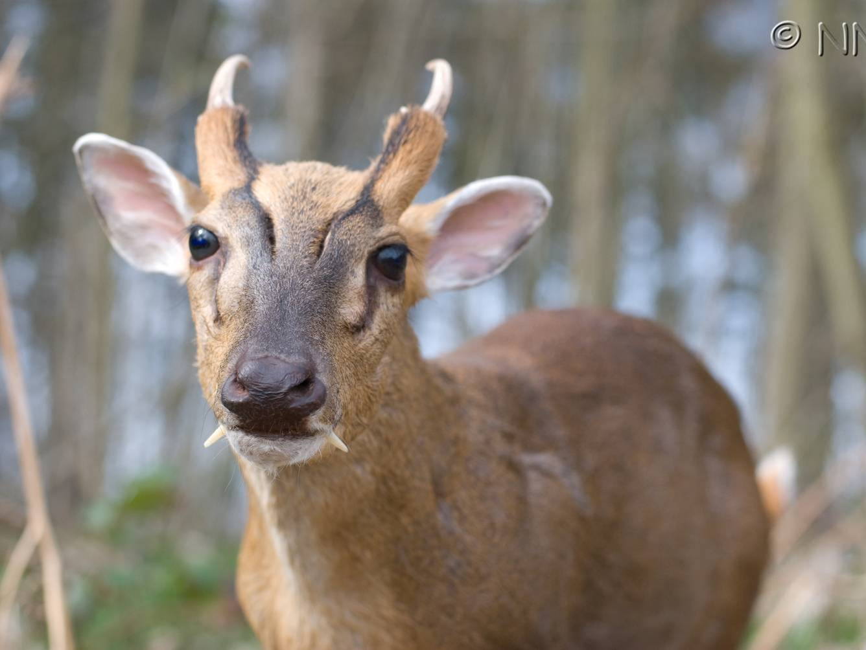
Citizen Science & Biological Recording
Notes:
1

Slide 2
Citizen Science & Biological Recording
Part i
What is biological recording?
UK infrastructure for biological recording
Part ii
Recording scheme examples
Data flow
Part iii
Why is biological recording important?
Evolution of biological recording
Part iv
Distribution atlases
Uses of biological records

Slide 3
Citizen Science & Biological Recording
Module Learning Outcomes:
Knowledge and understanding
1. Demonstrate critical awareness of the rapidly changing status of species in the natural environment, the implications for ecosystem services, and the approaches to addressing these problems in different ecosystems.
Intellectual, practical, affective and transferable skills
3. Critically assess conservation issues and communicate scientific arguments to a wide audience.

Slide 4
What is biological recording?
The standard definition is that it is recording of
What? – species, habitat
Where? – to some accuracy
When? – usually to day
Who? – quality control

Slide 5
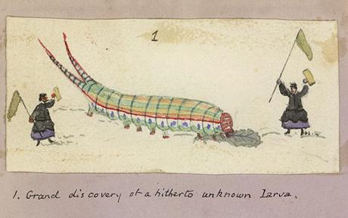
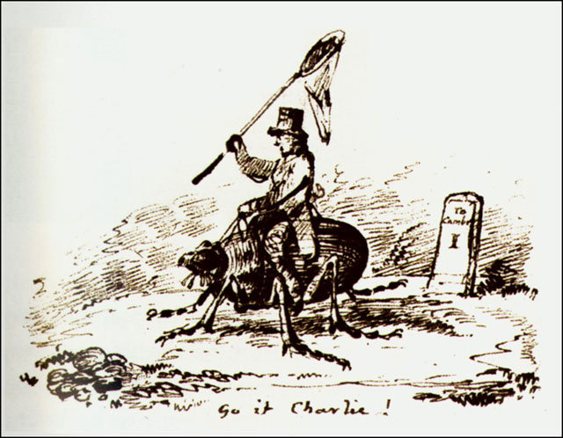
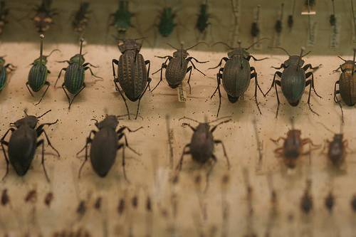
British tradition for recording

Slide 6



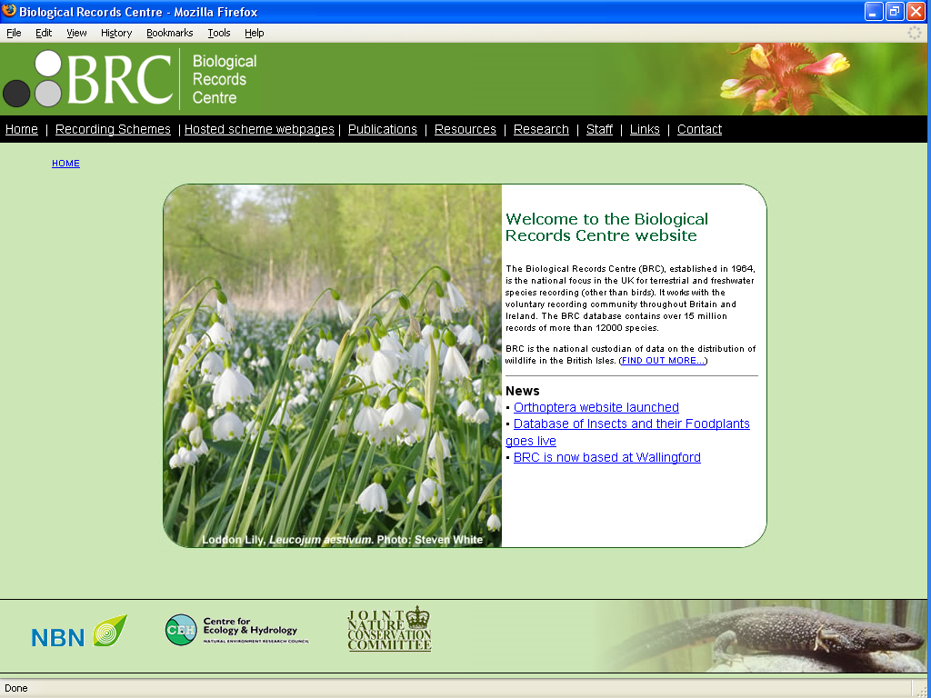

Slide 7
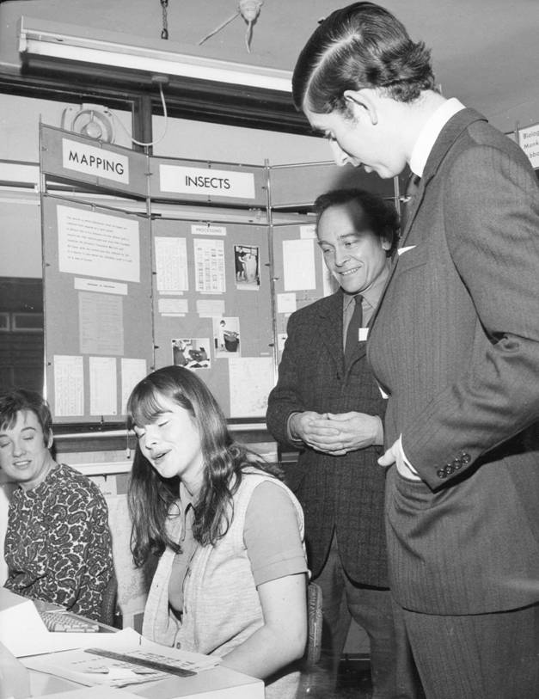
Biological Records Centre (BRC)
Established 1964
Original objective: Species distribution mapping

Slide 8
Biological Records Centre
BRC is UK national biodiversity observatory & archive
(terrestrial & freshwater organisms)
Supported by -
Conservation agencies (JNCC)
Research Council (NERC)
Volunteers – National Schemes & Societies

Slide 10
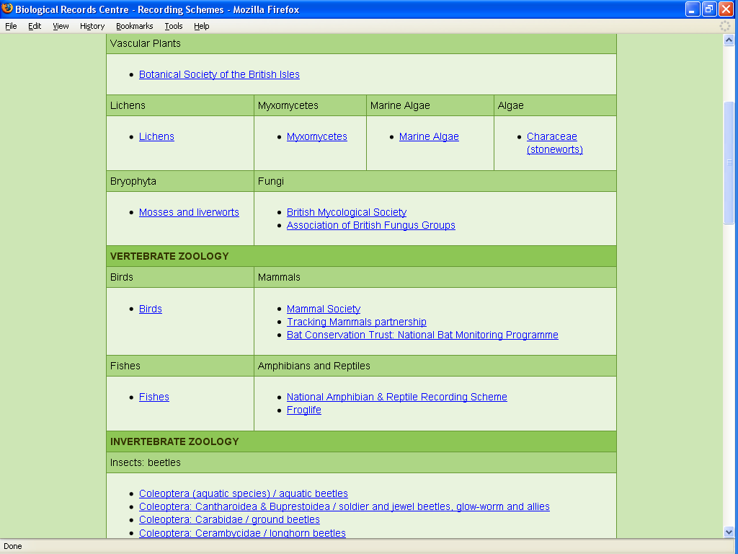
Notes:
80+ recording schemes

Slide 11

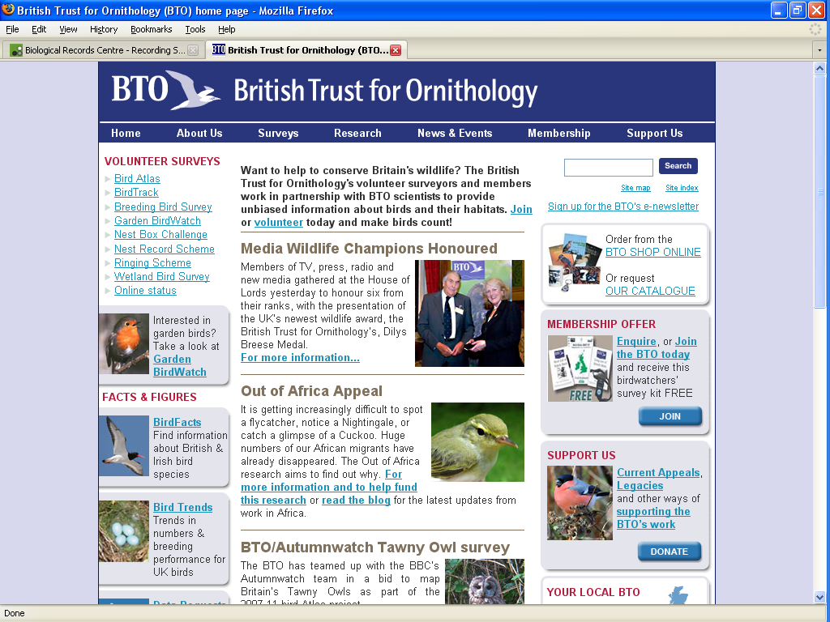
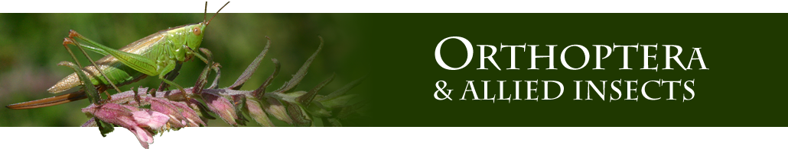
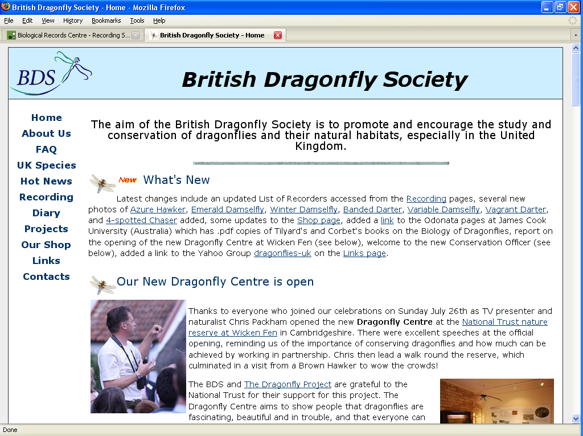






National recording schemes & societies

Slide 12
Citizen Science & Biological Recording
Part i
What is biological recording?
UK infrastructure for biological recording
Part ii
Recording scheme examples
Data flow
Part iii
Why is biological recording important?
Evolution of biological recording
Part iv
Distribution atlases
Uses of biological records

Slide 13
...most of our animal species are invertebrates

Slide 14
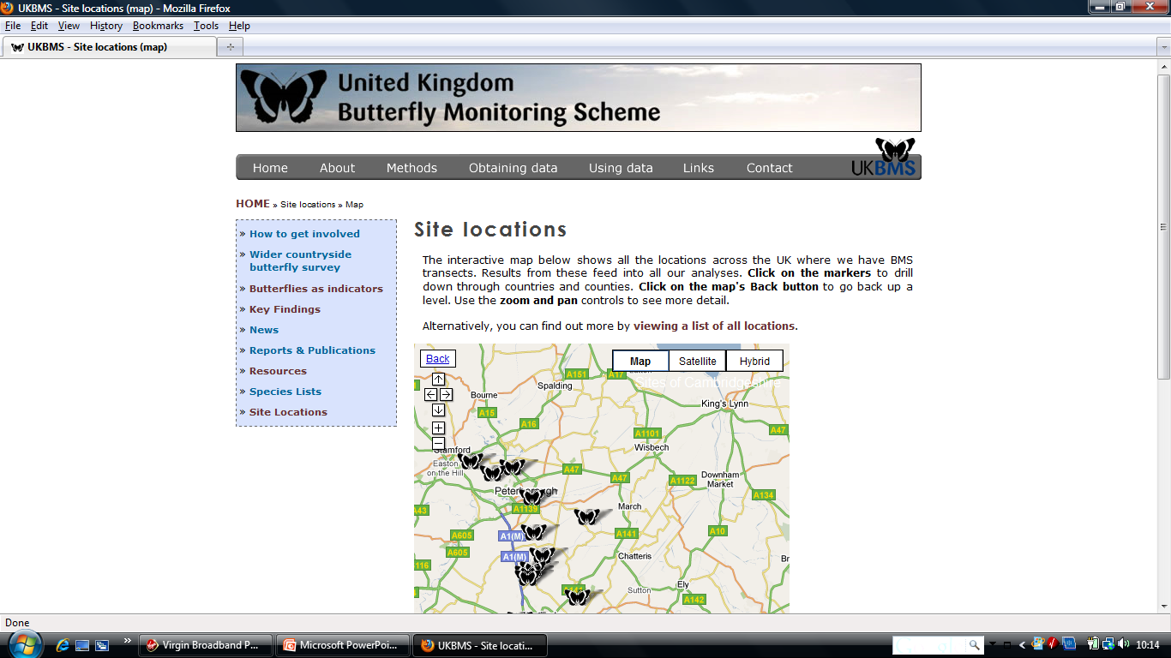
Weekly transects in season (26 per year)
32 years
1,500 sites
170,000 surveys
12.5 million butterfly records!
Notes:
14

Slide 15
Notes:
15

Slide 16
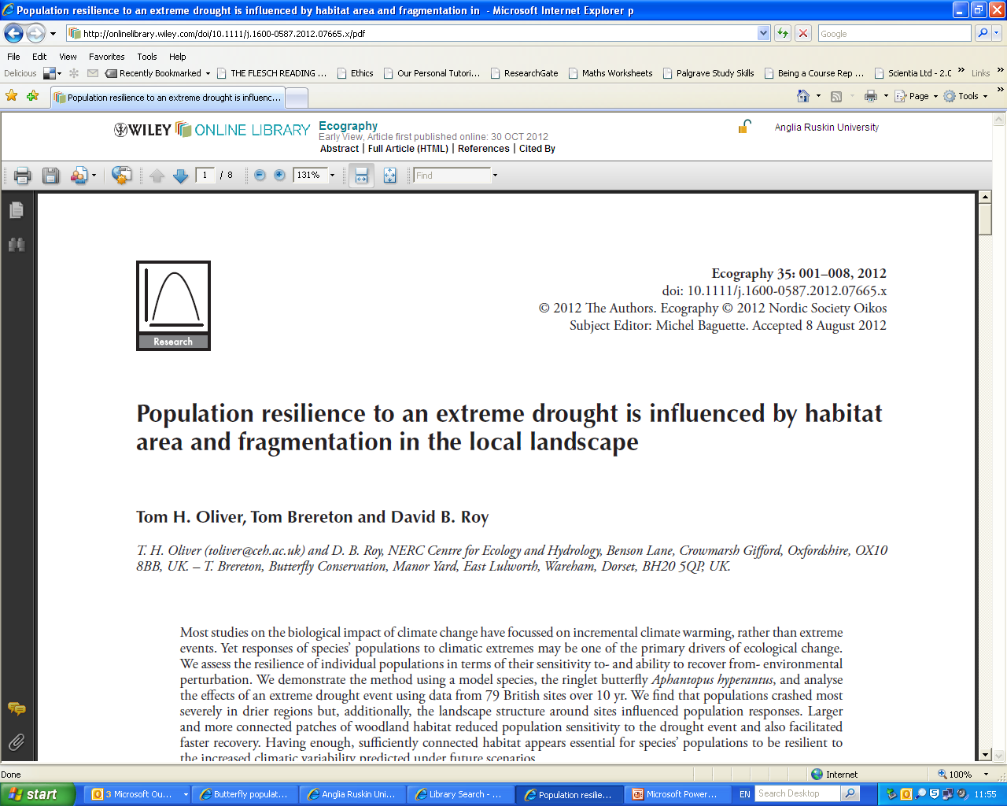
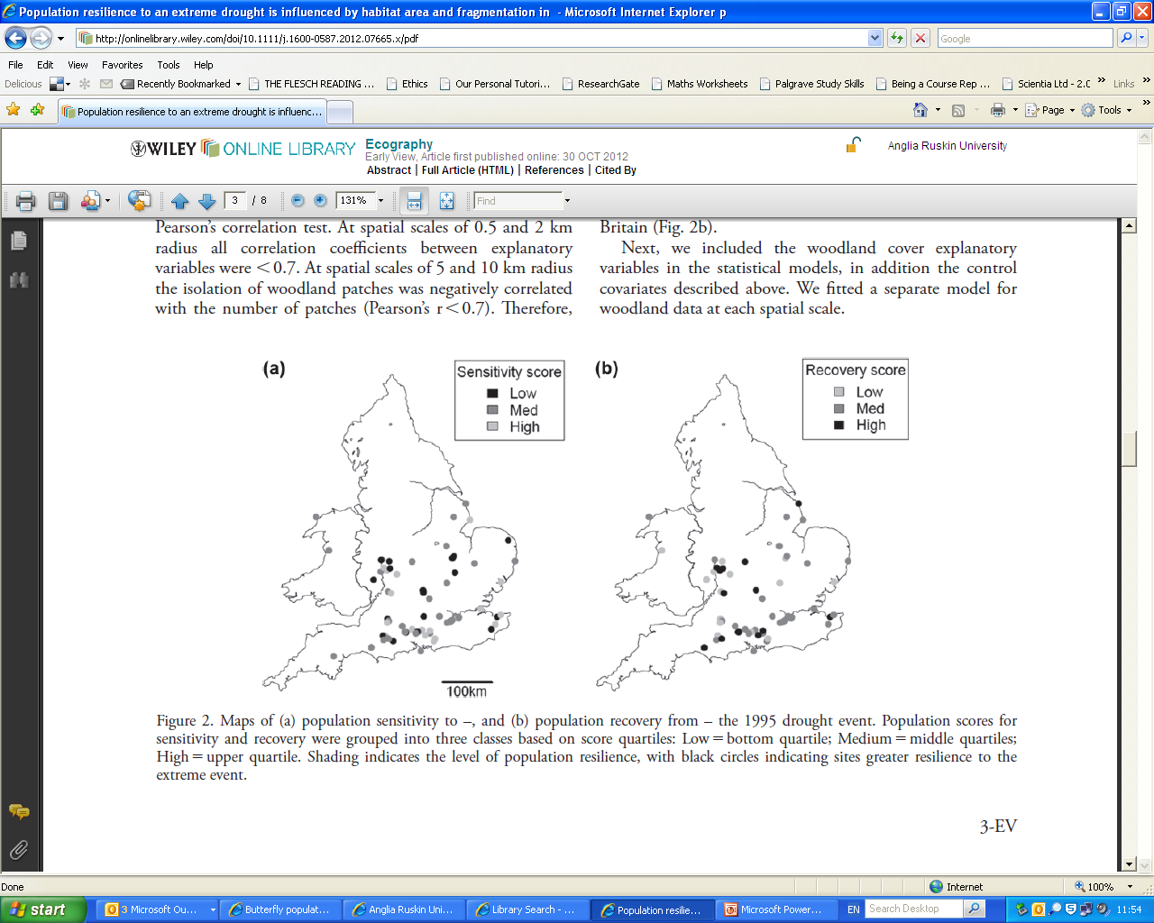
Ecography 35: 001–008, 2012 doi: 10.1111/j.1600-0587.2012.07665.x
Notes:
http://www.ceh.ac.uk/news/news_archive/Butterflypopulationsthreatenedbydroughtandlandscapefragmentation.html

Slide 17
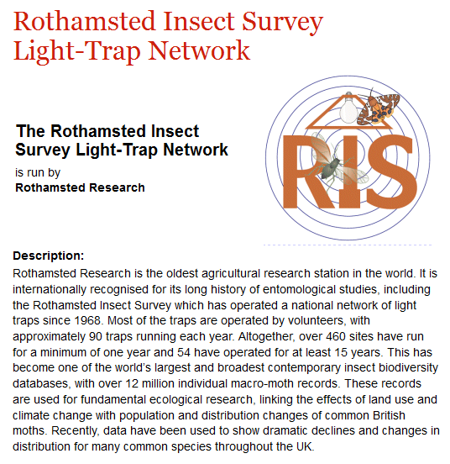
Notes:
From http://www.birds.cornell.edu/citscitoolkit/projects/rothamsted/insectsurvey/ (http://www.rothamsted.ac.uk/insect-survey/)
Rothamsted Research is the oldest agricultural research station in the world. It is internationally recognised for its long history of entomological studies, including the Rothamsted Insect Survey which has operated a national network of light traps since 1968. Most of the traps are operated by volunteers, with approximately 90 traps running each year. Altogether, over 460 sites have run for a minimum of one year and 54 have operated for at least 15 years. This has become one of the world’s largest and broadest contemporary insect biodiversity databases, with over 12 million individual macro-moth records. These records are used for fundamental ecological research, linking the effects of land use and climate change with population and distribution changes of common British moths. Recently, data have been used to show dramatic declines and changes in distribution for many common species throughout the UK.
17

Slide 18
Biological records: data flow
Volunteers recording species
National recording scheme
Biological Records
Centre
Quality control
Mapping
Quality control
Local Records Centres
NBN
Atlas
Data mapped & accessible to
public online

Slide 19
Biological records: data flow
Volunteers recording species
National recording scheme
Biological Records
Centre
Quality control
Mapping
Quality control
County recorders
Quality control
County recorders
Plants
Birds
Mammals
Dragonflies
Beetles
Butterflies
Local Records Centres
NBN
Atlas
Data mapped & accessible to
public online
Notes:
19

Slide 20
Citizen Science & Biological Recording
Part i
What is biological recording?
UK infrastructure for biological recording
Part ii
Recording scheme examples
Data flow
Part iii
Why is biological recording important?
Evolution of biological recording
Part iv
Distribution atlases
Uses of biological records

Slide 21
Why is biological recording important?
Assessment of environmental changes over time. Effects of -
climate change
pollution
habitat loss
habitat management
Decisions on whether development projects will affect rare species?
Need to know what species are present

Slide 22
Evolution of biological recording

Slide 23
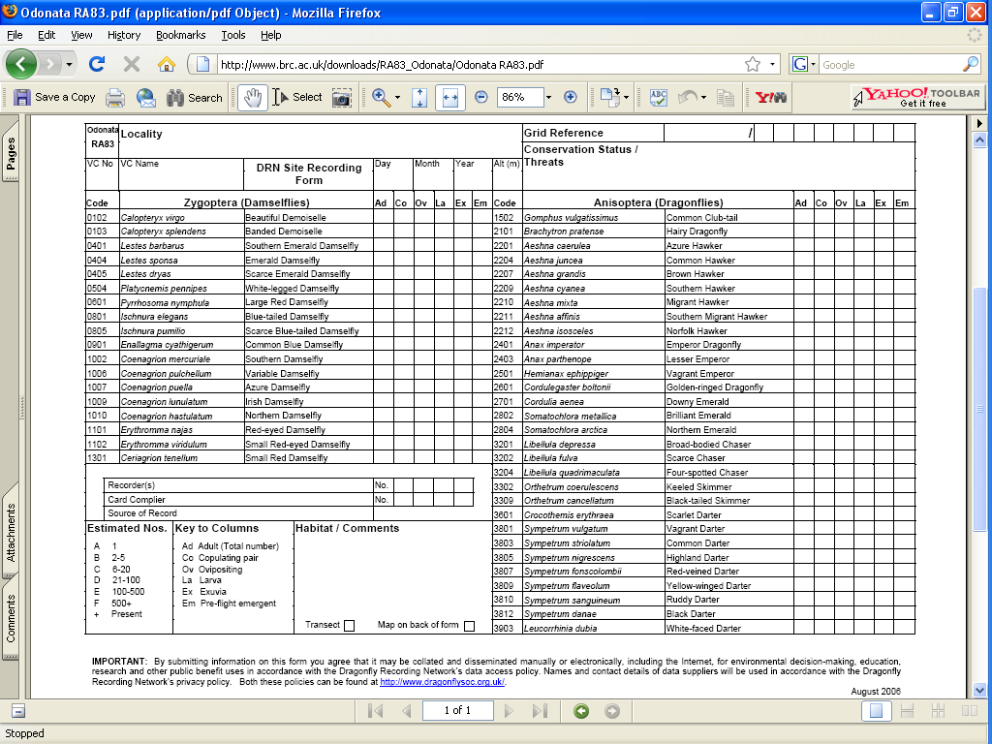
Evolution of recording – PAPER RECORDS

Slide 24
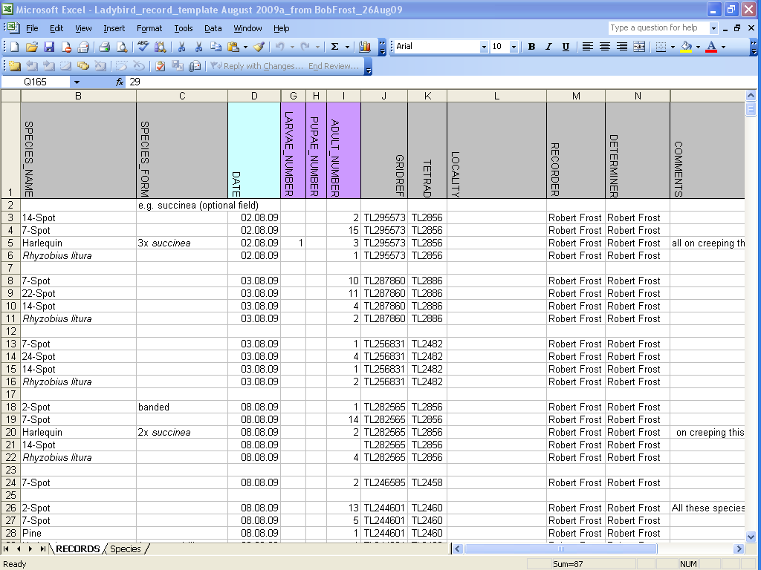
Evolution of recording - SPREADSHEETS

Slide 25
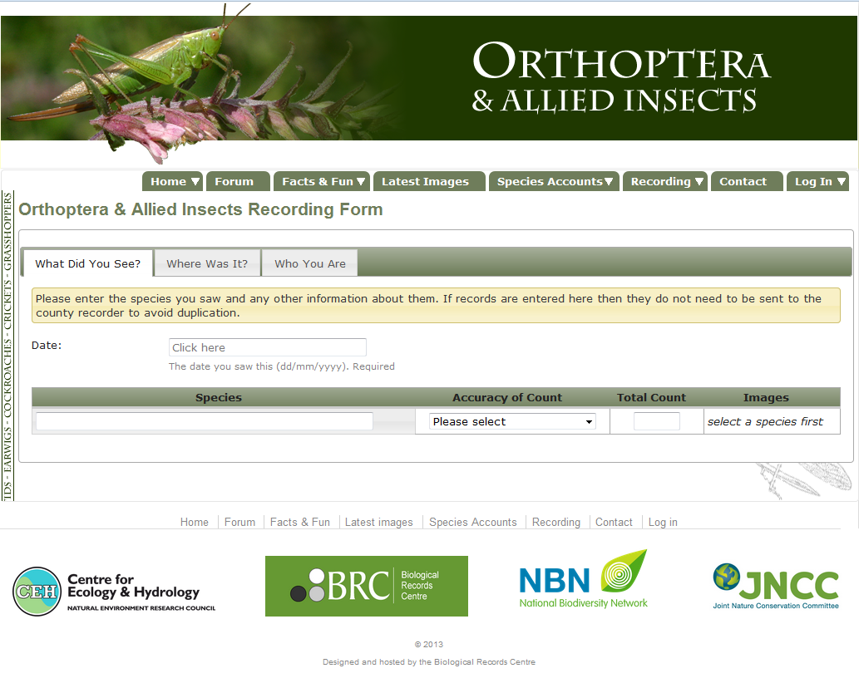
Evolution of recording – ONLINE RECORDING
www.orthoptera.org.uk
Notes:
http://www.orthoptera.org.uk/recording

Slide 26
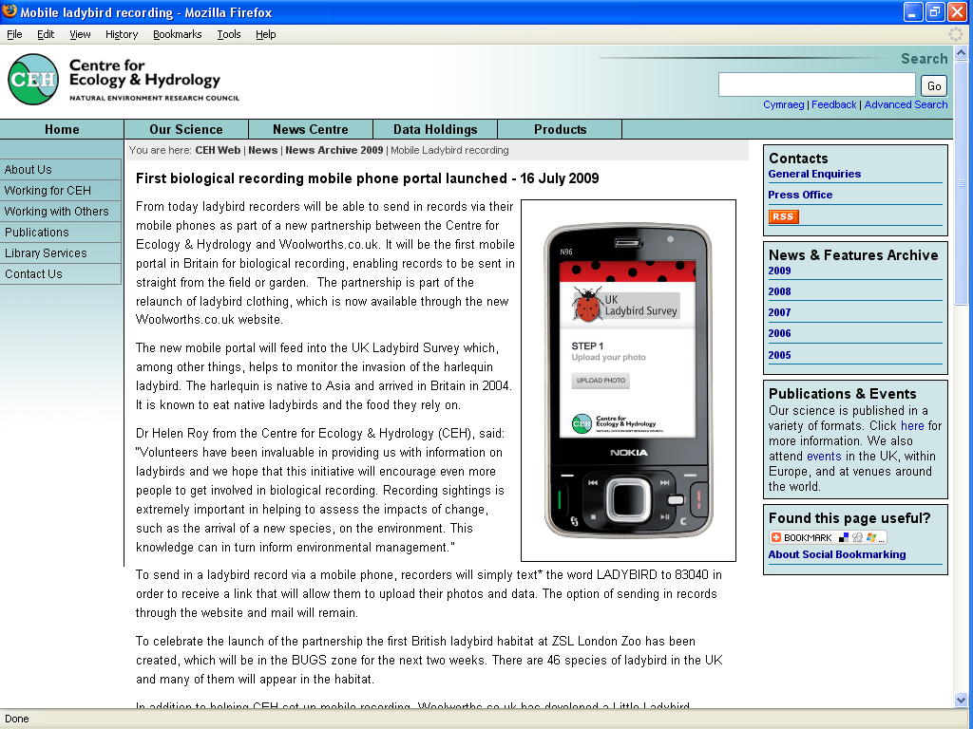
Evolution of recording – MOBILE PHONES

Slide 27
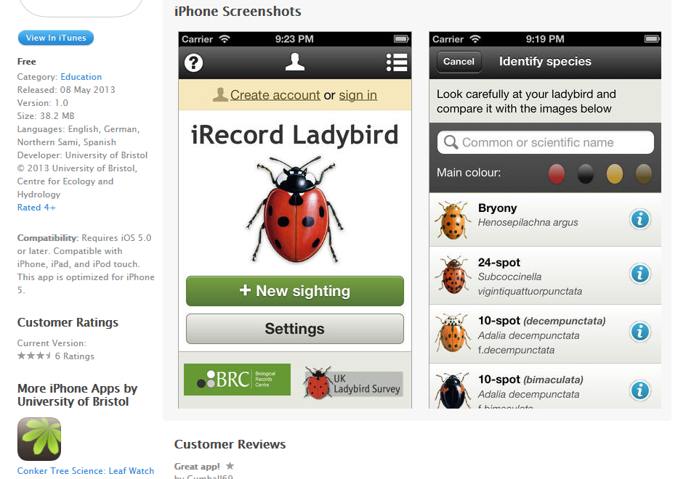
Evolution of recording – APPS

Slide 28
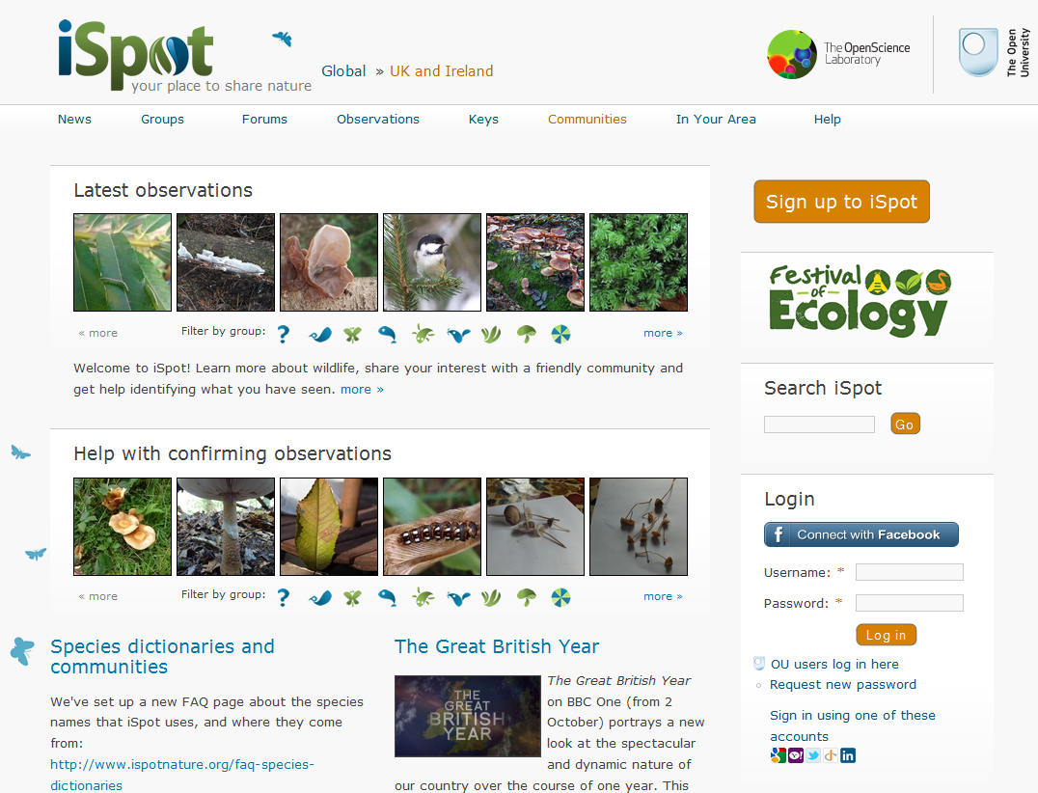
Evolution of recording – ONLINE FORUMS
www.ispotnature.org
Notes:
http://www.ispotnature.org/uk-and-ireland

Slide 29
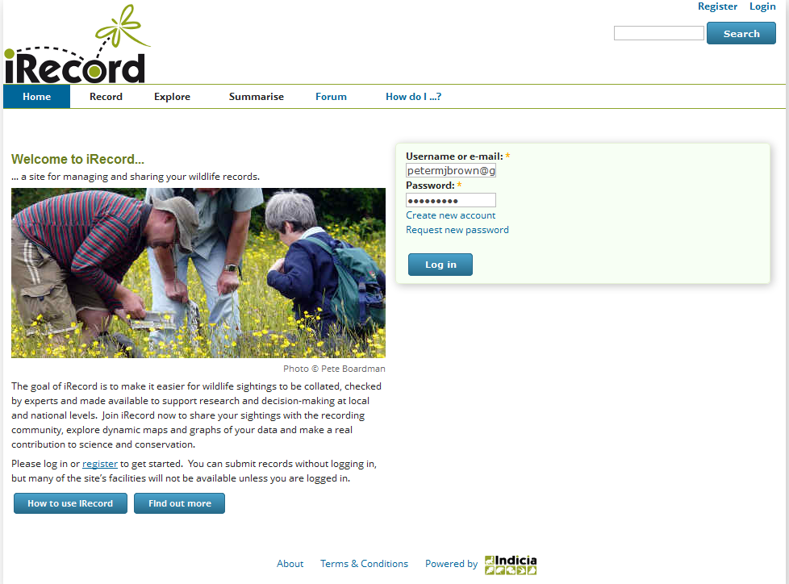
Evolution of recording – ONLINE FORUMS
www.brc.ac.uk/irecord
Notes:
http://www.brc.ac.uk/irecord/

Slide 30
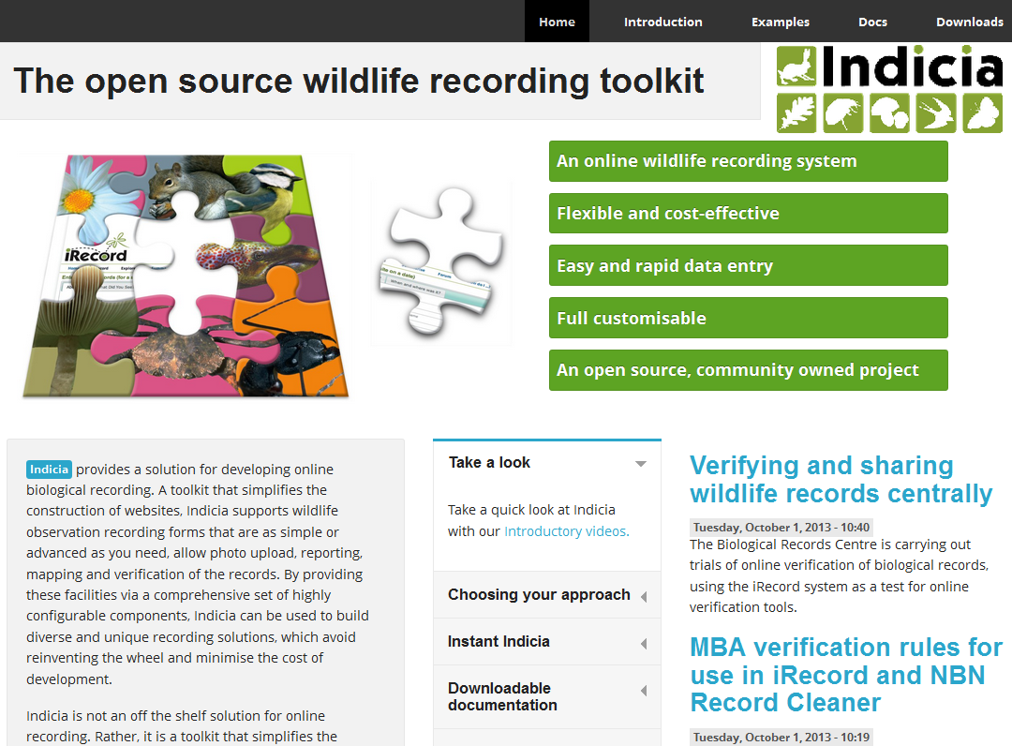
Evolution of recording - DIY
www.indicia.org.uk
Notes:
http://www.indicia.org.uk/
30

Slide 31
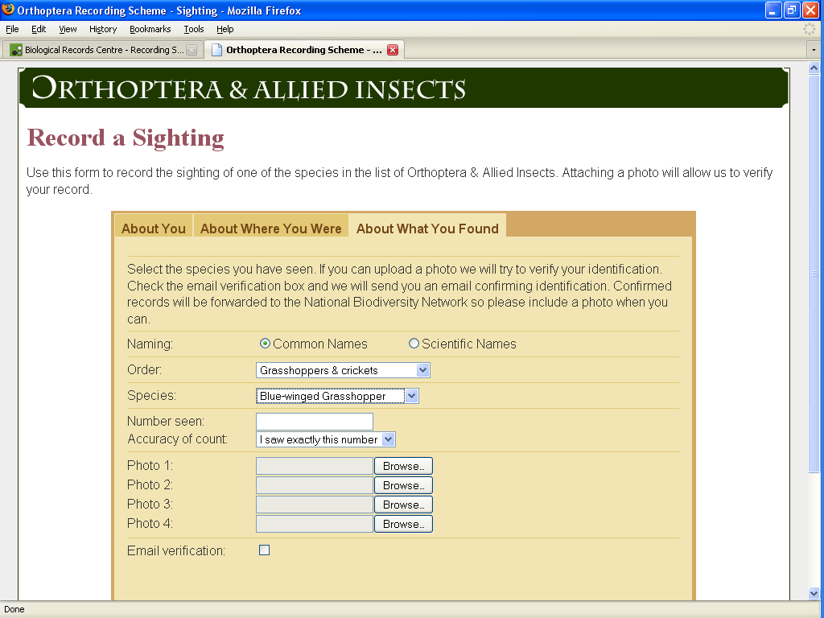
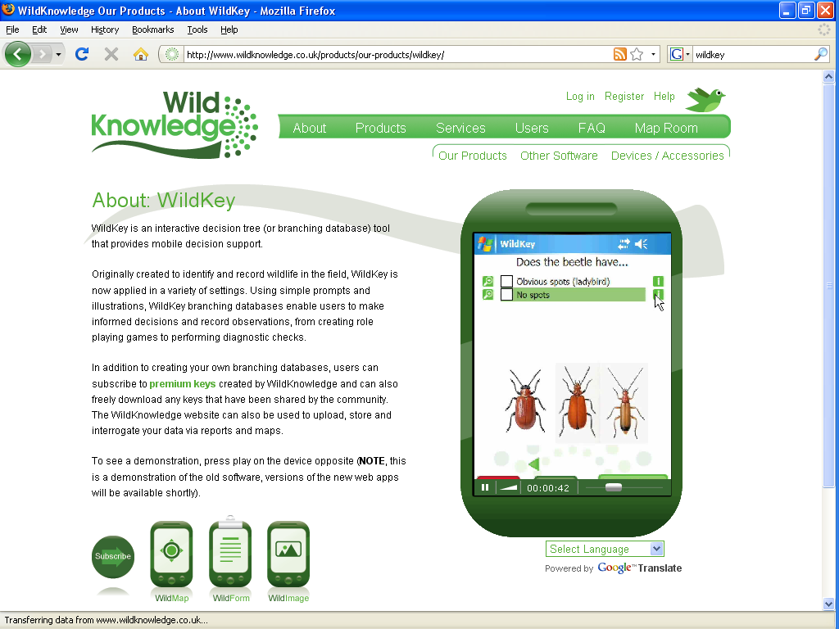
Evolution of recording
Flexibility for recording scheme
and recorder

Slide 32
Citizen Science & Biological Recording
Part i
What is biological recording?
UK infrastructure for biological recording
Part ii
Recording scheme examples
Data flow
Part iii
Why is biological recording important?
Evolution of biological recording
Part iv
Distribution atlases
Uses of biological records

Slide 33
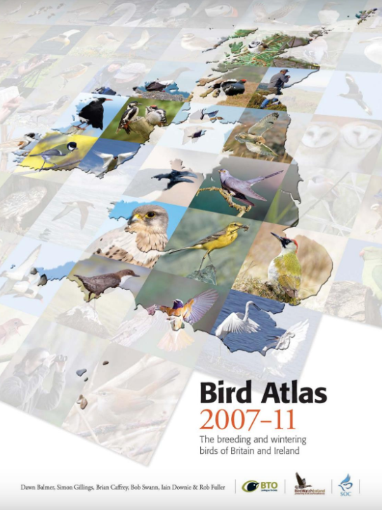
ATLASES: Mapping
distribution & range changes
1968-72
1988-91
2007-11
1954-60
Initial and repeat surveys
Notes:
https://www.bto.org/our-science/projects/birdatlas/about/making

Slide 34
Atlas uses - examples
Site protection (e.g. identifying biodiversity hotspots)
Highlighting rarity of species - ‘Red data’ – nationally rare species - regional conservation strategies
Coverage of protected areas (SSSI)
Changes at protected sites in relation to wider countryside
Invasive species
Range changes
Interpreting causes of change

Slide 35
Uses of biological records

Slide 36
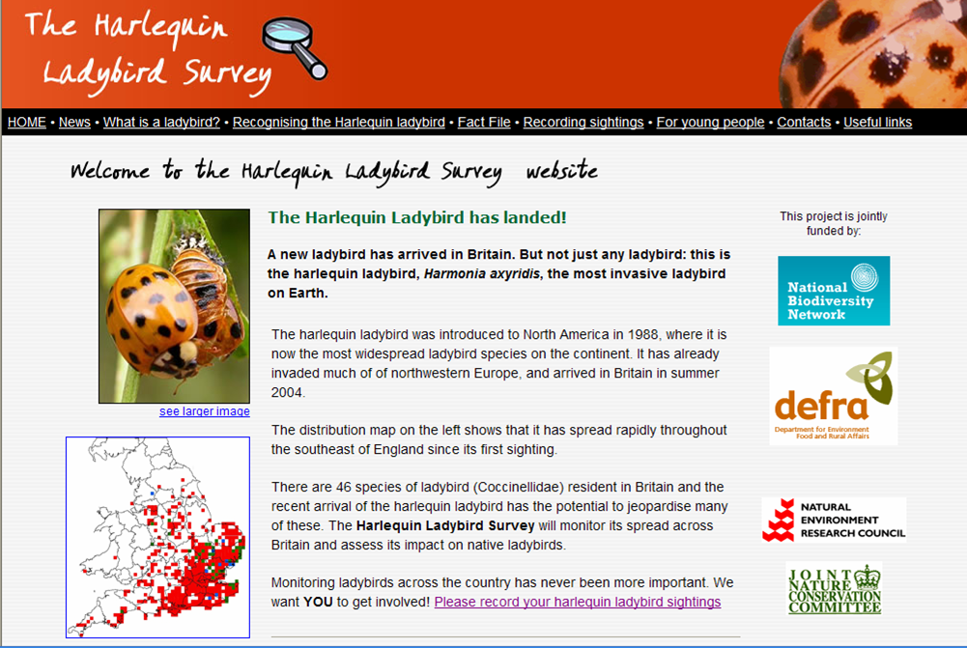
Uses of biological records – SPREAD OF NON-NATIVE SPECIES
Notes:
36

Slide 37
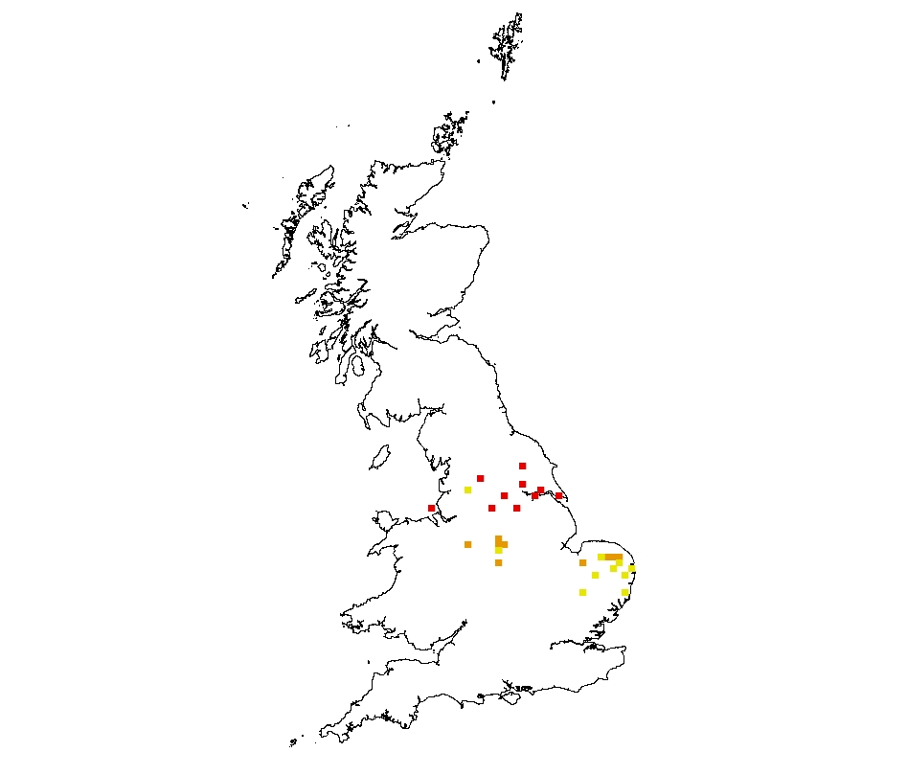
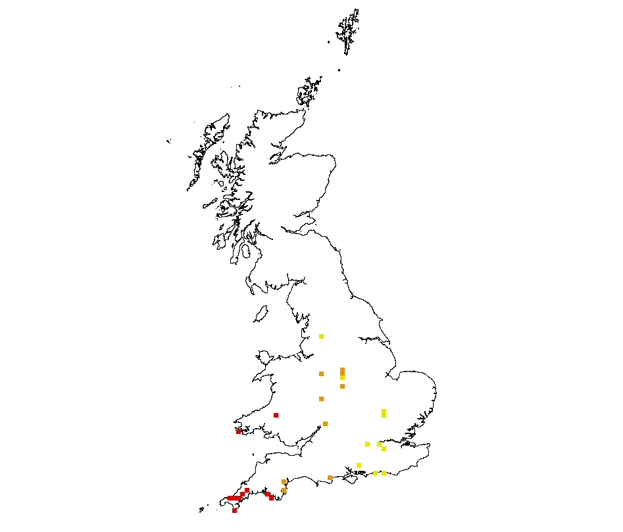
Uses of biological records – SPREAD OF NON-NATIVE SPECIES
Quantifying range expansions
Northerly spread = 58 km yr⁻¹ Westerly spread = 144 km yr⁻¹
(a) Ten most northerly squares
(b) Ten most westerly squares
Notes:
37

Slide 38
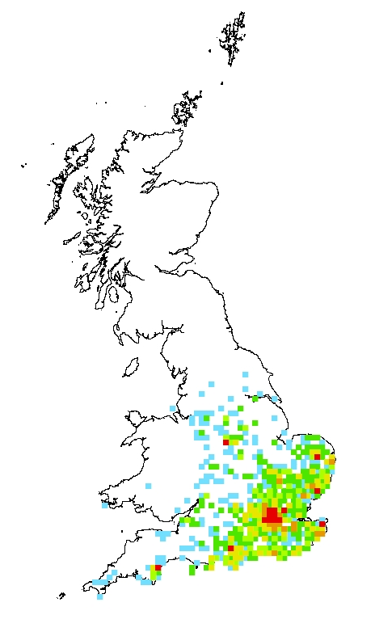
Density of records
Uses of biological records – SPREAD OF NON-NATIVE SPECIES
Density of records of harlequin ladybirds
(red = 50+ records per square; orange = 20 to 49; yellow = 10 to 19; pale green = 6 to 9; dark green = 2 to 5; blue = 1)
Notes:
38

Slide 39
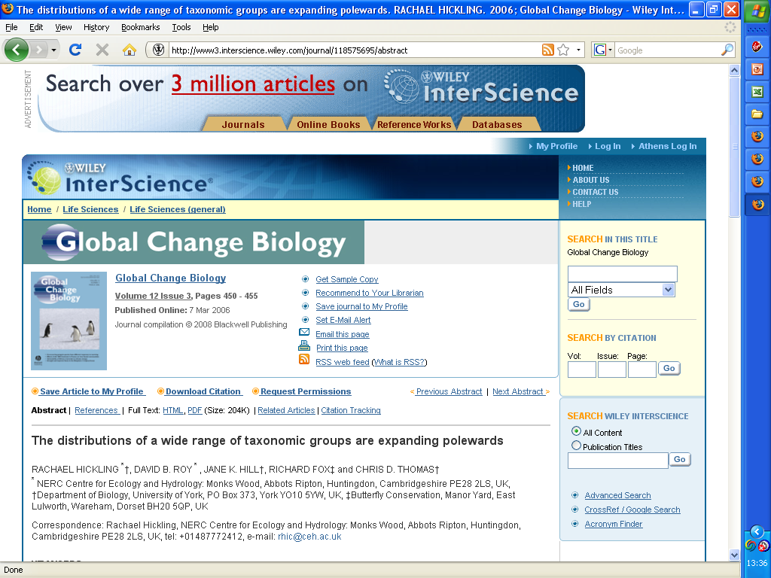
Uses of biological records – PROVIDING EVIDENCE OF CLIMATE CHANGE

Slide 40
Uses of biological records – PROVIDING EVIDENCE OF CLIMATE CHANGE
Many species have expanded northwards (and uphill) in the last 25 years
Dragonflies
Spiders
Butterflies
Grasshoppers
Fishes
Mammals

Slide 41
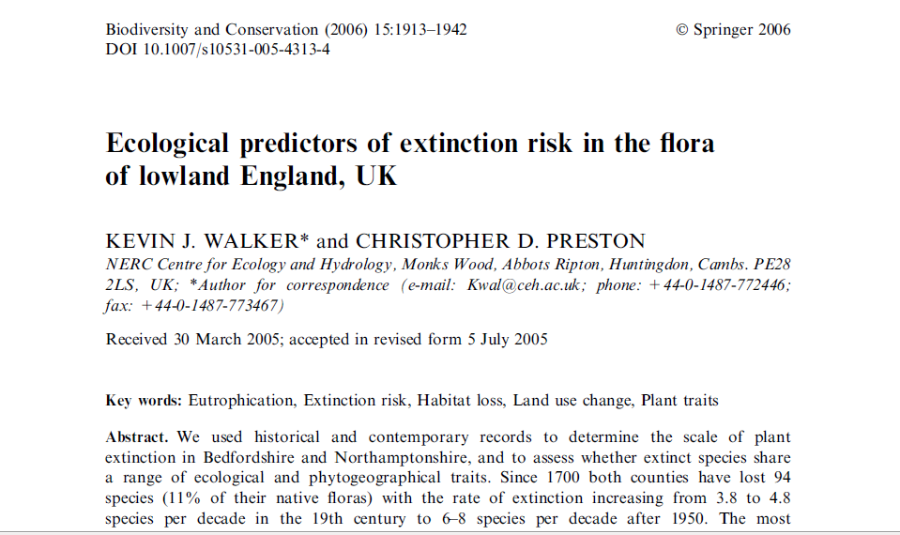
Uses of biological records – PROVIDING EVIDENCE OF EXTINCTION RISK

Slide 42
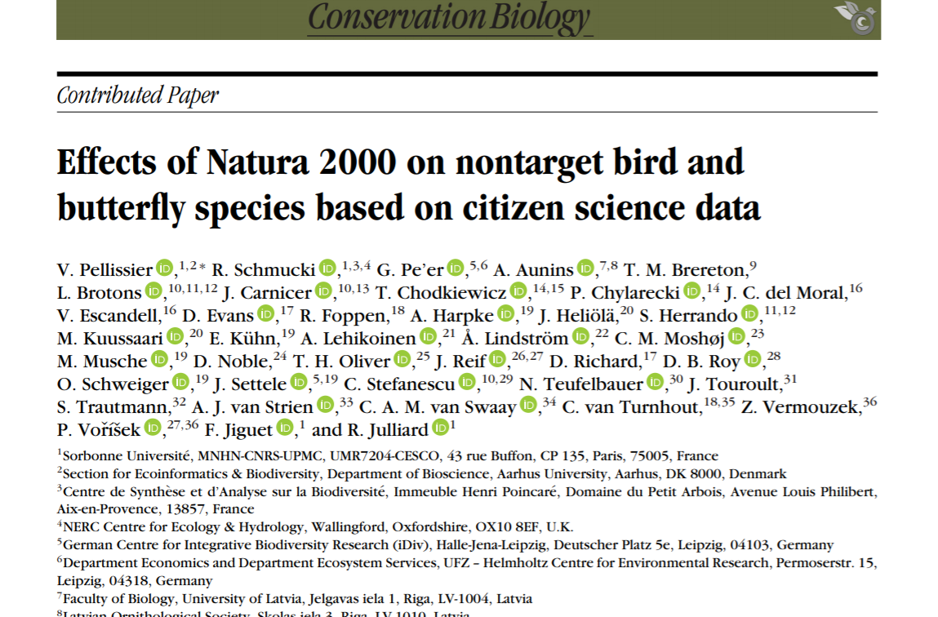
Uses of biological records – EFFECTS OF SITE PROTECTION
Notes:
Abstract: The European Union’s Natura 2000 (N2000) is among the largest international networks of protected areas. One of its aims is to secure the status of a predetermined set of (targeted) bird and butterfly species. However, nontarget species may also benefit from N2000. We evaluated how the terrestrial component of this network affects the abundance of nontargeted, more common bird and butterfly species based on data from longterm volunteer-based monitoring programs in 9602 sites for birds and 2001 sites for butterflies. In almost half of the 155 bird species assessed, and particularly among woodland specialists, abundance increased (slope estimates ranged from 0.101 [SD 0.042] to 3.51 [SD 1.30]) as the proportion of landscape covered by N2000 sites increased. This positive relationship existed for 27 of the 104 butterfly species (estimates ranged from 0.382 [SD 0.163] to 4.28 [SD 0.768]), although most butterflies were generalists. For most species, when land-cover covariates were accounted for these positive relationships were not evident, meaning land cover may be a determinant of positive effects of the N2000 network. The increase in abundance as N2000 coverage increased correlated with the specialization index for birds, but not for butterflies. Although the N2000 network supports high abundance of a large spectrum of species, the low number of specialist butterflies with a positive association with the N2000 network shows the need to improve the habitat quality of N2000 sites that could harbor open-land butterfly specialists. For a better understanding of the processes involved, we advocate for standardized collection of data at N2000 sites.
https://conbio.onlinelibrary.wiley.com/doi/pdf/10.1111/cobi.13434?casa_token=OsEPTHC1GCYAAAAA:Pi9GDzwBbgfmNnsas-2fHbMcAopGKr8RsVscVkHYGrQojxBgBX7i5Z3KV7WjOZ5f7MpdP7EPGei28A

